Slide 1
RSA and Quantum Encryption

Slide 2
RSA variable construction
Pick two large primes, p and q. Compute n = p * q
Calculate f(n). In original paper, f(n) = (p-1) * (q-1)
Choose k such that f(n) and k are relatively prime
Solve for d such that dk = 1 mod(n)
Release n and k. d is desired result

Slide 3
RSA encryption/decryption
Message is turned into number, m
Find c = m^{k} modn to encrypt
Find c^{d} = m^{kd} = m modn to decrypt

Slide 4
RSA issues
RSA is ancient and there are numerous papers describing ways to crack it
Fundamentally an issue with increasing strength of computers being able to factor n.
Quantum computing. Shor’s/Grover’s

Slide 5
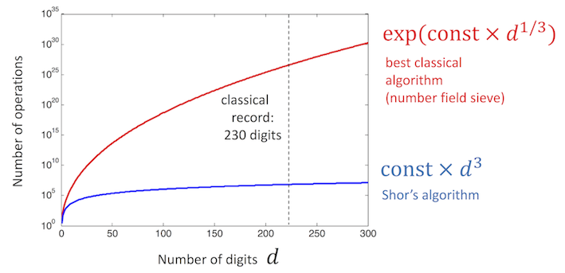

Slide 6
Briefest overview of quantum computing
Quantum computing uses qubits instead of bits.
Qubits can not only be 1 and 0 but a superposition of both.
This allows for 1 computation on a quantum computer to accomplish the same as many computations on classical computers.

Slide 7
Shor’s and Factoring N
See if N is a factor of 2 or an exponent
Choose x between 2 and n-1. If gcd(N,x) is not 1, can attempt to factor.
Find r such that x^{r} = 1 mod n. If r is odd, start over.
Find gcd(N, x^{r/2 +/- 1}) = d. If d = 1 or N, start over

Slide 8
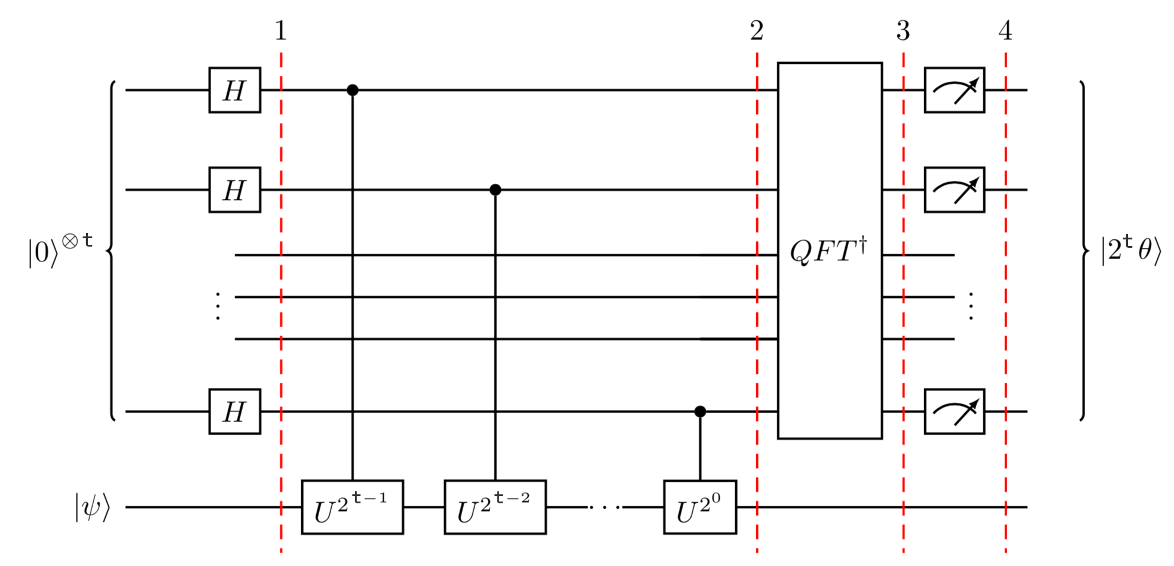
One may note all this can be done on a classical computer
Quantum computing’s utility is find r in “Find r such that x^{r} = 1 mod n”
Done through quantum phase estimation although not originally used

Slide 9
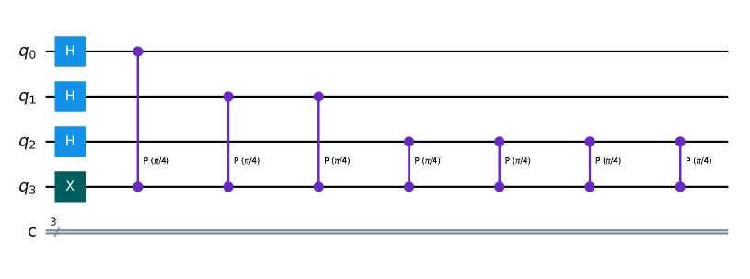
Set bottom wire to 1 with not gate
Apply Hadamard gate to all other qubits which are counting qubits
Apply gate T(a) such that P|1> = e^{ia} |1>
Apply 2^{n} gates of T to the nth wire

Slide 10
Apply inverse Quantum Fourier Transform(QFT)
Measure to output wires

Slide 11
Current issues/state of quantum computing
Qubits cannot be passed between processors
Qubits are noisy
Around 10 million for a 50-qubit computer not including cost needed to operate near absolute zero.

Slide 12
Post Quantum Cryptography
Like how quantum computing is changing, cryptography is too
NIST has announced 4 algorithms that are quantum resistant.
The one proposed is Crystals Kyber
Even now, there are flaws being found with the algorithms, but the algorithms are continuing to be updated.

Slide 13
Sources used
#https://www.math.uchicago.edu/~may/VIGRE/VIGRE2007/REUPapers/FINALAPP/Calderbank.pdf
#https://en.wikipedia.org/wiki/RSA_(cryptosystem)
https://quantum-computing.ibm.com/composer/docs/iqx/guide/shors-algorithm
https://www.forbes.com/sites/forbestechcouncil/2021/05/06/rsa-is-dead---we-just-haventaccepted-ityet/?sh=18b29e215d22
https://learn.qiskit.org/course/ch-algorithms/quantum-phase-estimation
https://www.purevpn.com/blog/quantum-computer-cost/
https://www.technologyreview.com/2023/01/06/1066317/whats-next-for-quantum-computing/
https://www.darkreading.com/vulnerabilities-threats/quantum-decryption-breakthrough-not-so-fast
https://thehackernews.com/2023/03/experts-discover-flaw-in-us-govts.html
https://www.nist.gov/news-events/news/2022/07/nist-announces-first-four-quantum-resistant-cryptographic-algorithms

